Slide 1
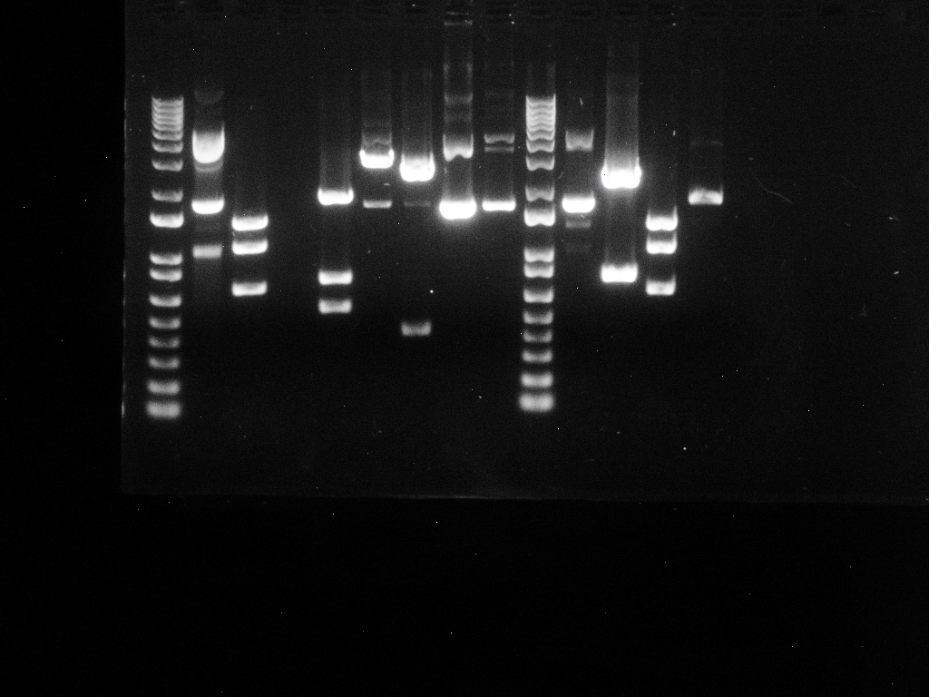
1 2 3 4 5
10180 -
4072 -
7126 -
5090 -
3054 -
2036 -
1636 -
1018 -
517, 506-
396 -
344 -
298 –
220-
201 -
154 -

Slide 2
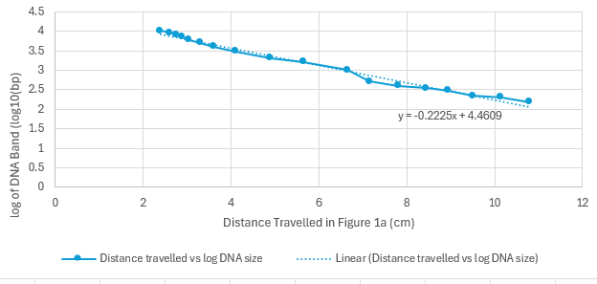
Distance Travelled vs log of DNAs
Linear line of best fit s

Slide 3
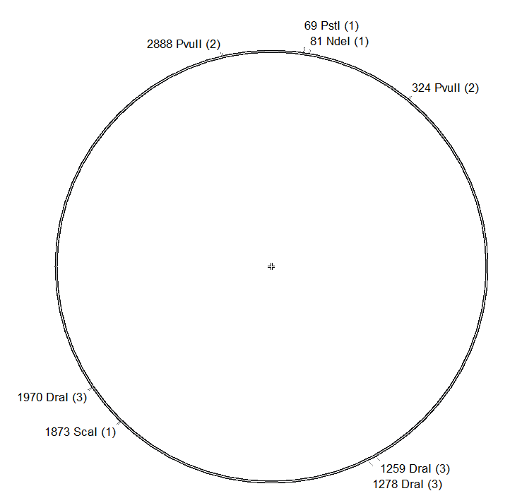
pGEM-T
3000bp

Slide 4
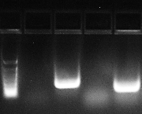
1 2 3 4 5
4000 bp –
2000 bp –
unidenti-
fiable
100 bp –

Slide 5
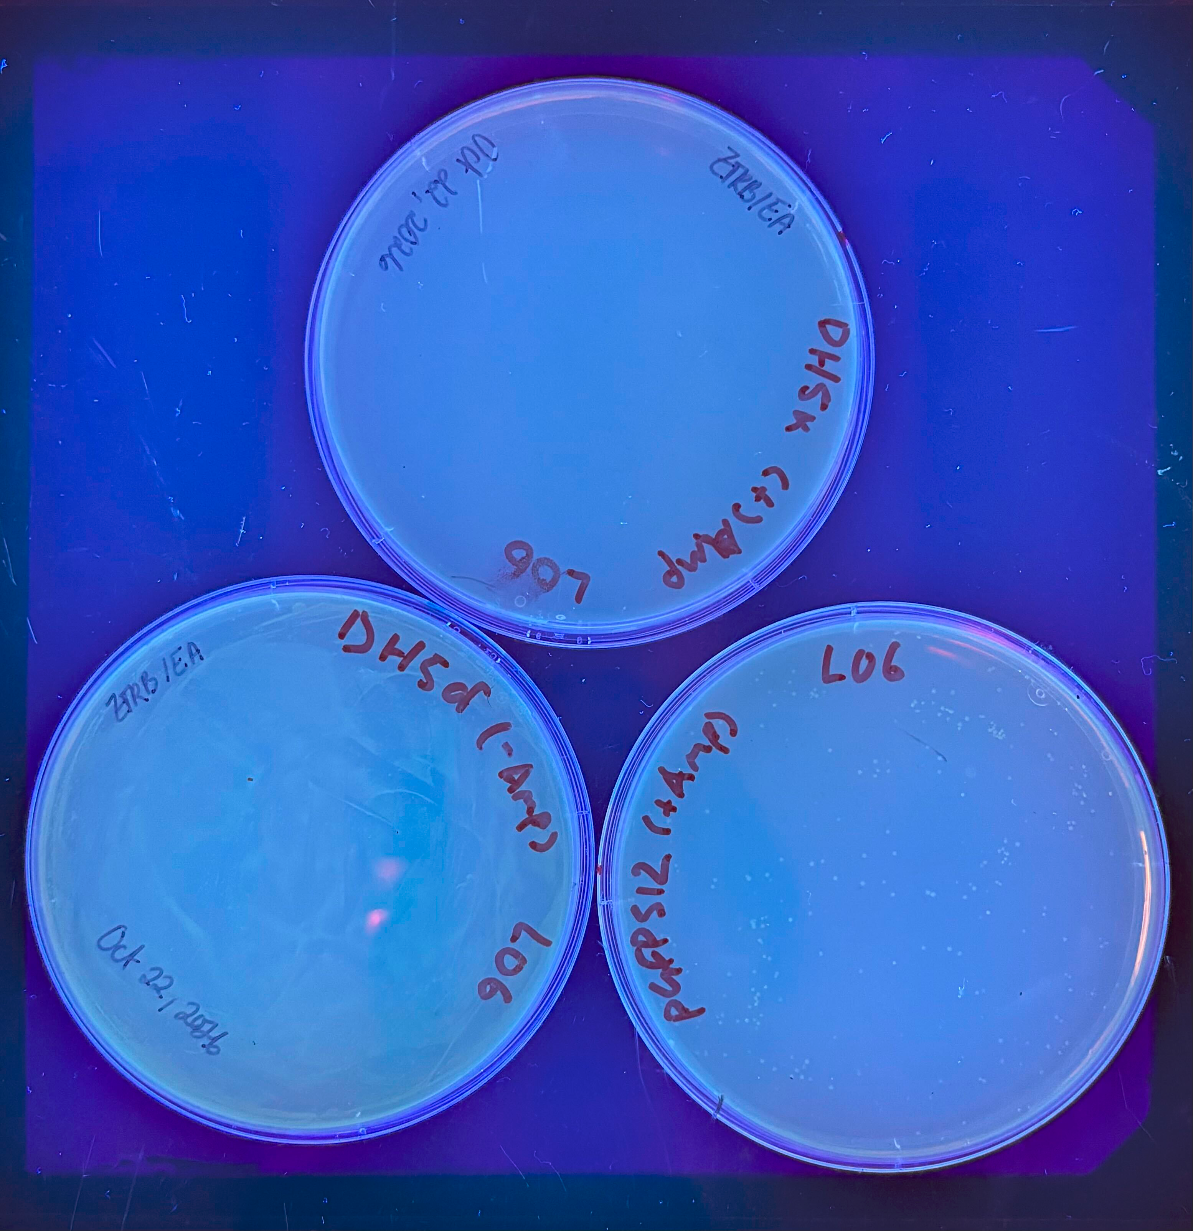
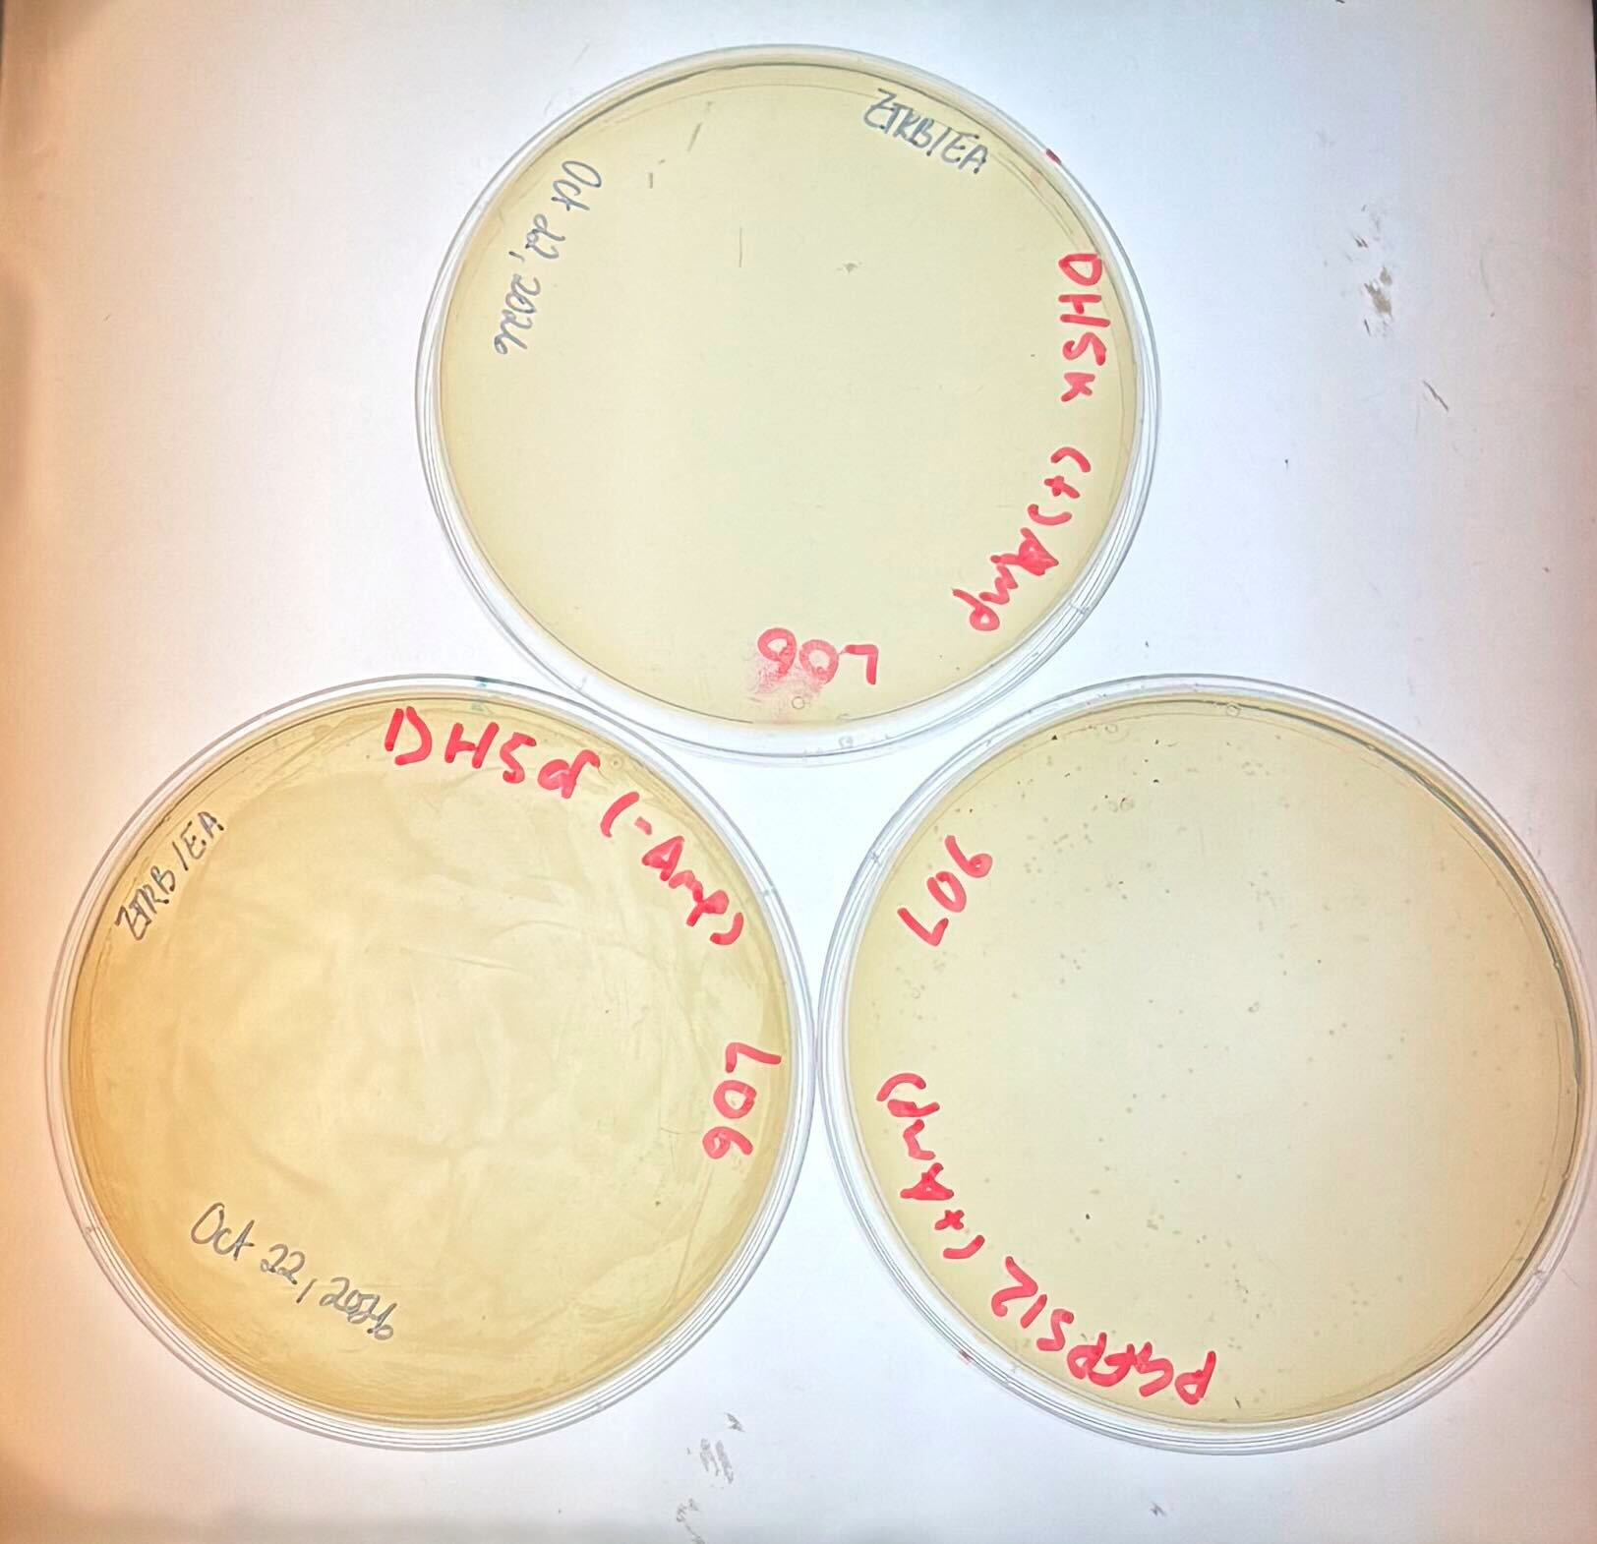
Control under UV + vis light

Slide 6
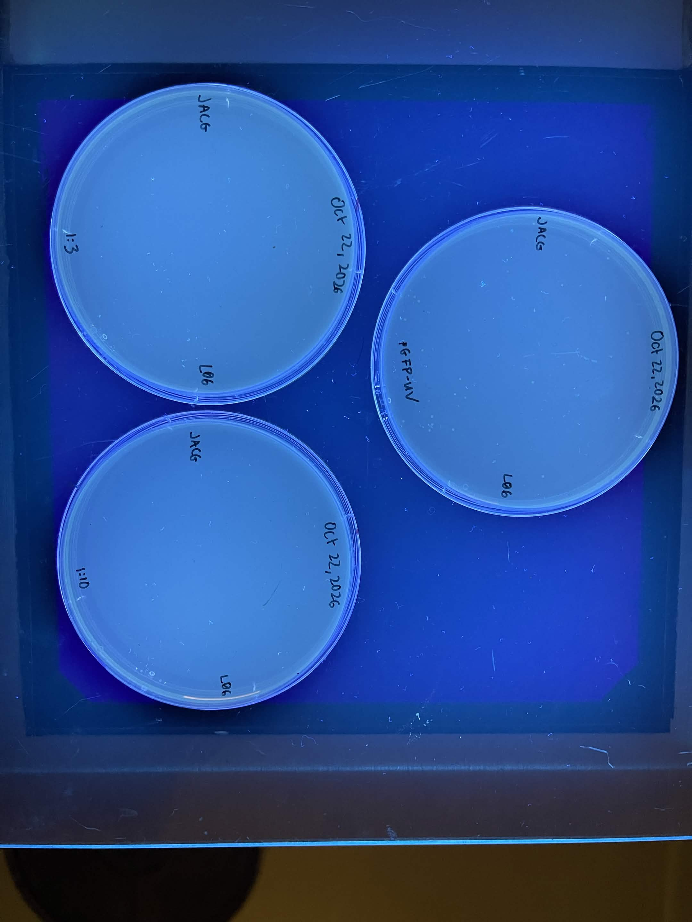
Ours under UV

Slide 7
Flora + eva’s

Slide 8
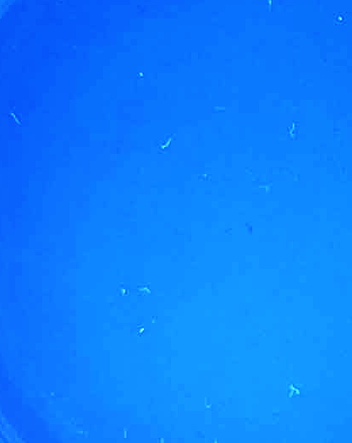
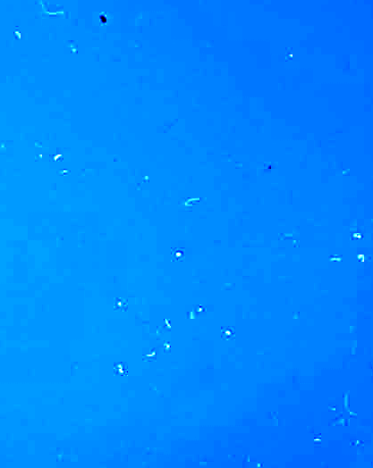
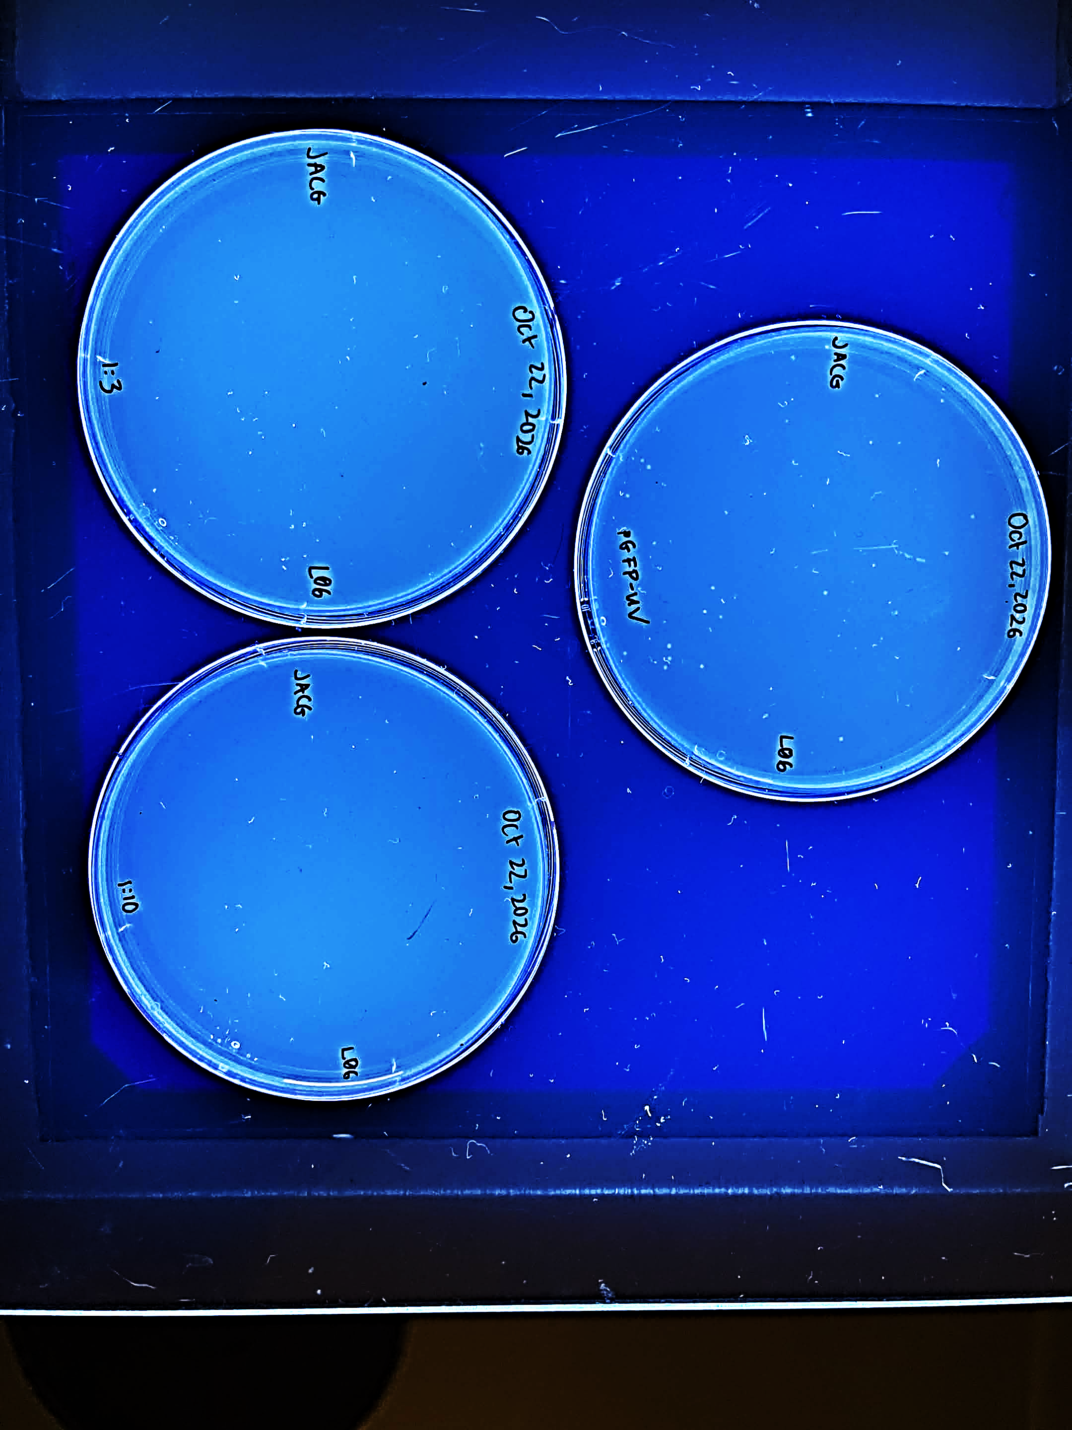
Figure 2
1:3 1:10 pGFP-UV

Slide 9
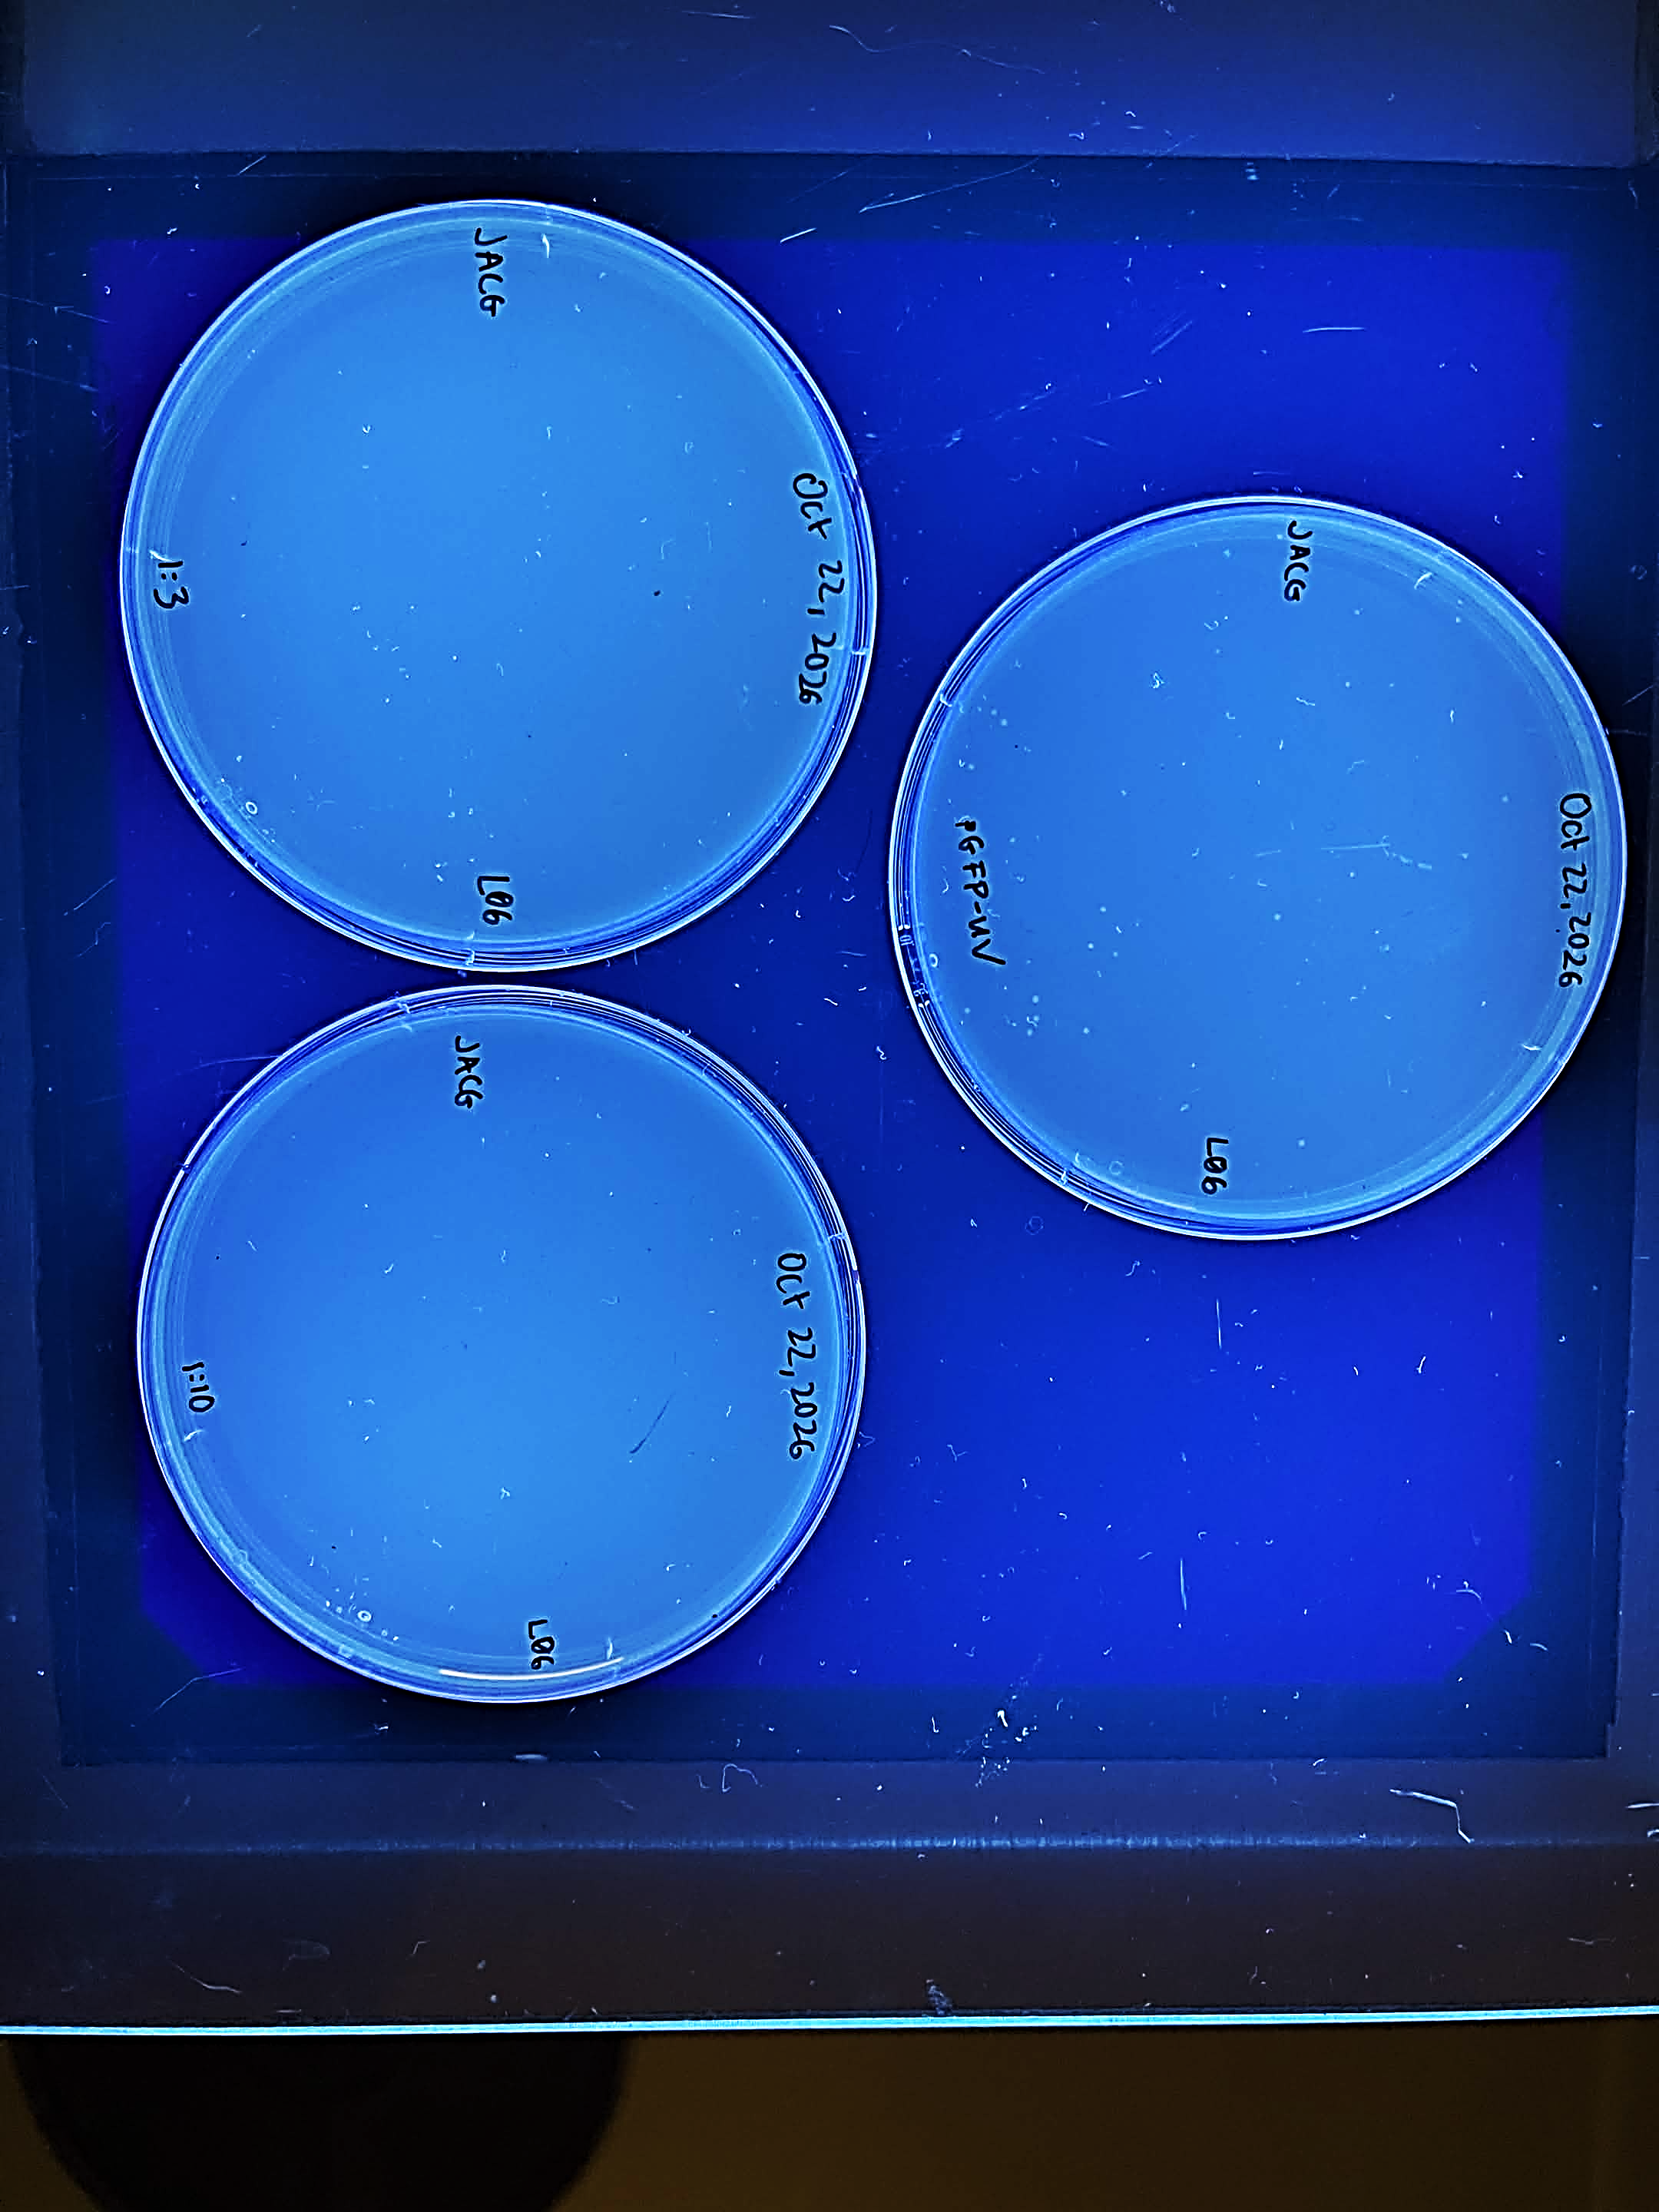
Figure 2
pGFP-UV

Slide 10
pGFP-UV

Slide 11
a
b
c
e f g
d
pGFP-UV

Slide 12
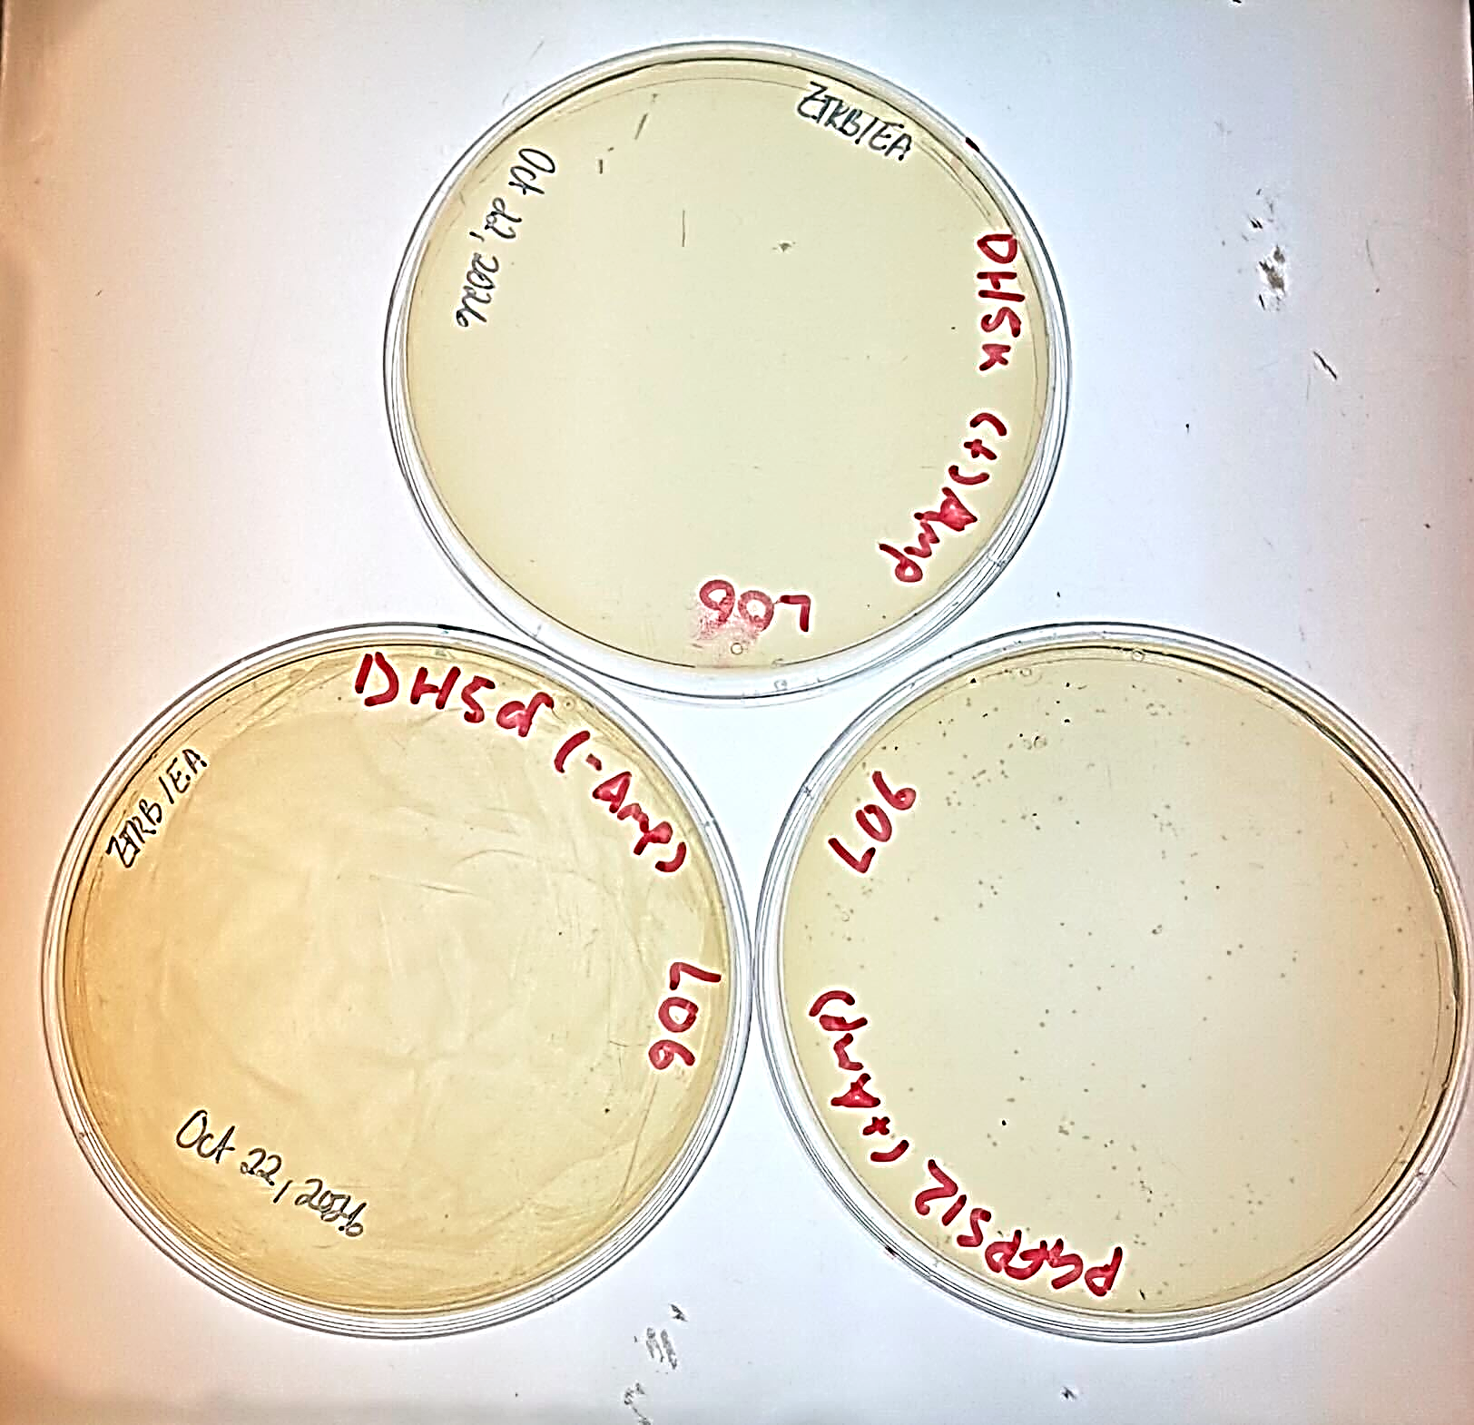
Cells - amp
pGFP-UV

Slide 13
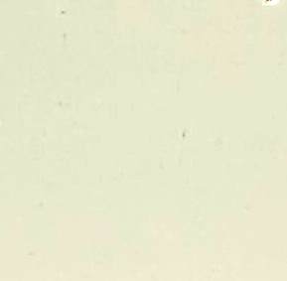
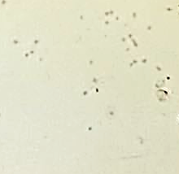
Amp + cells

Slide 14
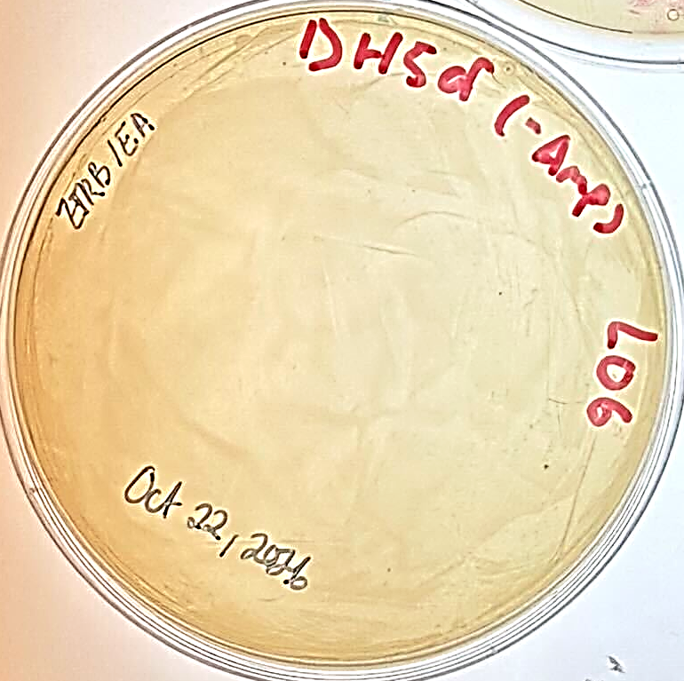
pGFP-UV

